Slide 1
Software Engineering Fundamental Revision Online Interaction Class

Slide 2
CHAPTER ONE
Definition of software
Software Engineering vs. Computer Science
Failure curve of Hardware and software
Software Myths
Software development life cycle (SDLC)
Software Development methods

Slide 3
Software (set of instruction + design diagrams+ necessary databases)
Software Engineering : Creation and design of the software .
Computer Science: Broad approach to the study of the principles and use of computers that covers both theory and application

Slide 4
Characteristics of Software
software has characteristics that are considerably different than those of hardware:
Software is developed ; it is not manufactured (Both process focuses to achieve high quality, for hardware can introduce quality problems that are nonexistent for a software)
Software doesn’t “wear out.”
3. Software is custom build

Slide 5
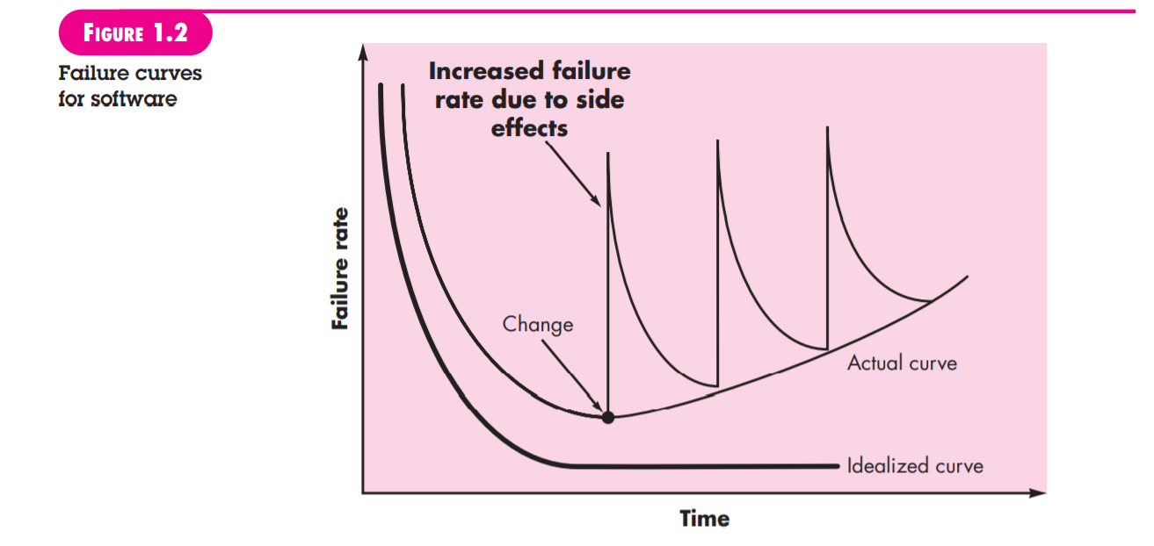
Characteristics of software
2. Software doesn’t wear out but it does deteriorates

Slide 6
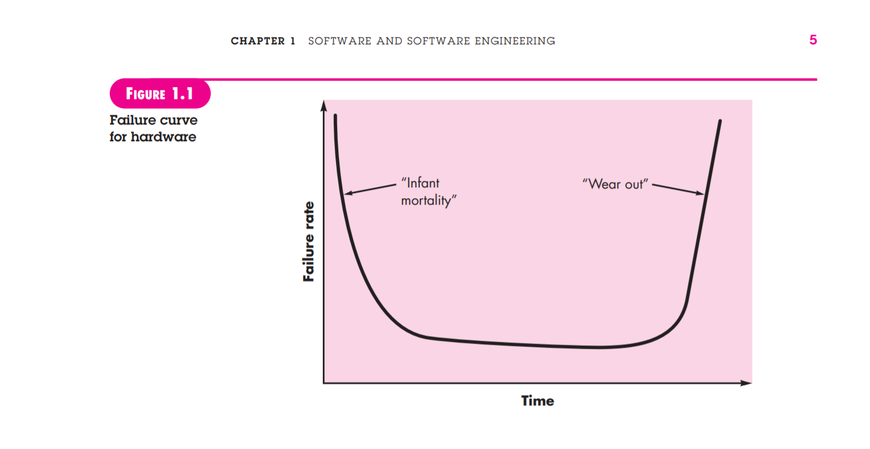
Characteristics of Software
2. Software doesn't wear out but hardware does

Slide 7
Software Myths
Management myths
Myth: We already have a book that’s full of standards and procedures for building software. Won’t that provide my people with everything they need to know?
Reality: Are software practitioners aware of its existence? Does it reflect modern software engineering practice? Is it complete? Is it adaptable?

Slide 8
Software Myths
Management Myths
Myth :If we get behind schedule, we can add more programmers and catch up
Reality :new people are added, people who were working must spend time educating the newcomers, thereby reducing the amount of time spent on productive development effort

Slide 9
Software Myths
Management Myth
Myth: If I decide to outsource the software project to a third party, I can just relax and let that firm build it.
Reality: If an organization does not understand how to manage and control software projects internally, it will invariably struggle when it outsources software projects.

Slide 10
Software Myths
Customer myths
Myth: A general statement of objectives is sufficient to begin writing programs—we can fill in the details later.
Reality: an ambiguous “statement of objectives” is a recipe for disaster.

Slide 11
Software Myths
Customer
Myth: Software requirements continually change, but change can be easily accommodated because software is flexible.
Reality :When requirements changes are requested early (before design or code has been started), the cost impact is relatively small. However, as time passes, the cost impact grows rapidly

Slide 12
Software Myths
Practitioner’s myths.
Myth: Once we write the program and get it to work, our job is done
Reality: Industry data indicate that between 60 and 80 percent of all effort expended on software will be expended after it is delivered to the customer for the first time

Slide 13
Software Myths
Practitioner’s myths
Myth: Until I get the program “running” I have no way of assessing its quality
Reality: Quality focuses from at the time of requirement analysis

Slide 14
Software Myths
Myth: The only deliverable work product for a successful project is the working program
Reality: A variety of work products (e.g., models, documents, plans) provide a foundation for successful engineering and, more important, guidance for software support.

Slide 15
Software Myths
Practitioners Myths
Myth: Software engineering will make us create voluminous and unnecessary documentation and will invariably slow us down.
Reality: Software engineering is not about creating documents. It is about creating a quality product. Better quality leads to reduced rework. And reduced rework results in faster delivery times.

Slide 16
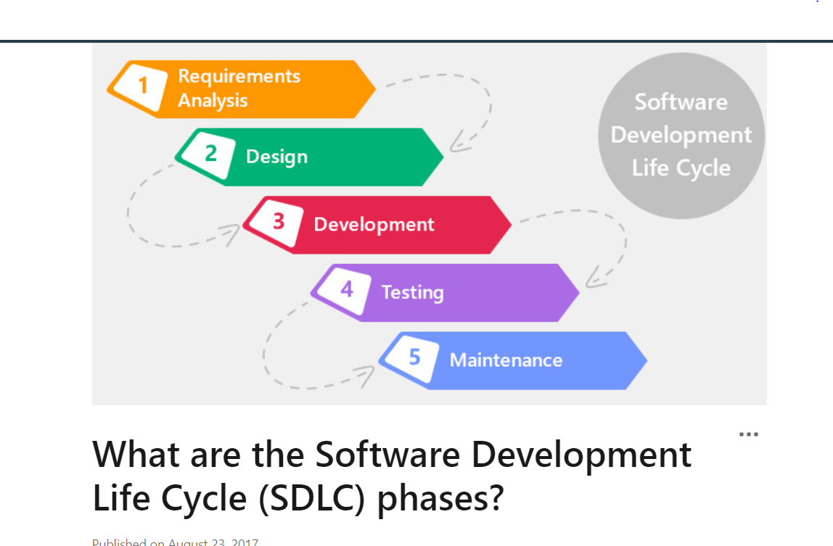
Software Development Life Cycle (SDLC)

Slide 17
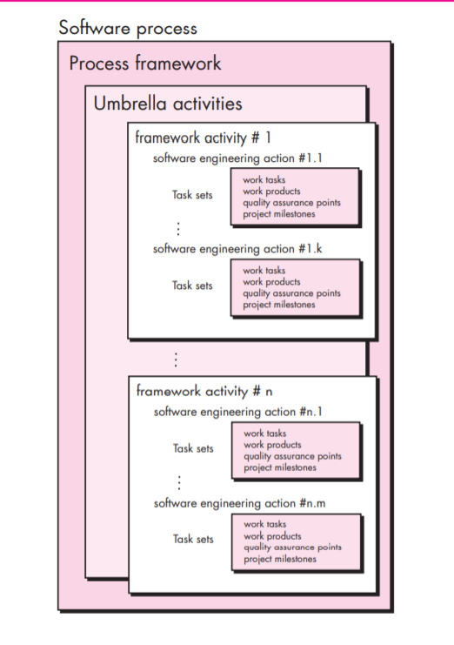
Process Framework

Slide 18
Umbrella Activities
Software Project Management
Formal Technical Review
Software Quality Assurance
Software Configuration Management
Documentation
Reusability Management
Measurement
Risk Management

Slide 19
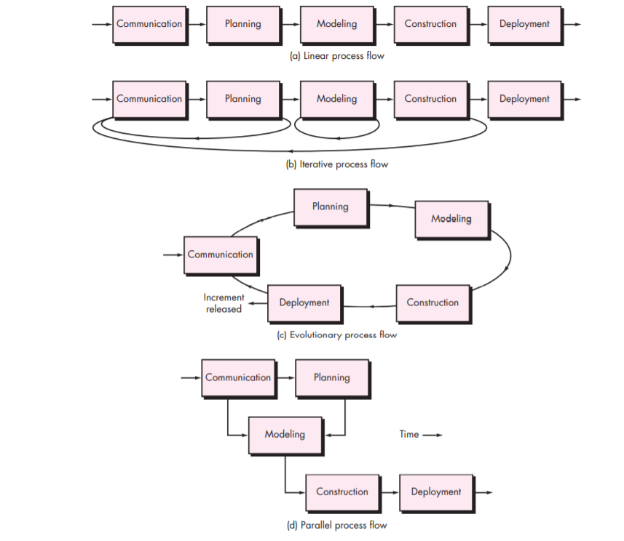
Process Flow

Slide 20
Generic Process Model
Communication
Planning
Modeling
Construction
Deployment

Slide 21
Process Model of Software Engineering
Waterfall model
Incremental model
Prototype model
Spiral model
RAD model
Agile (Framework->Scrum)

Slide 22
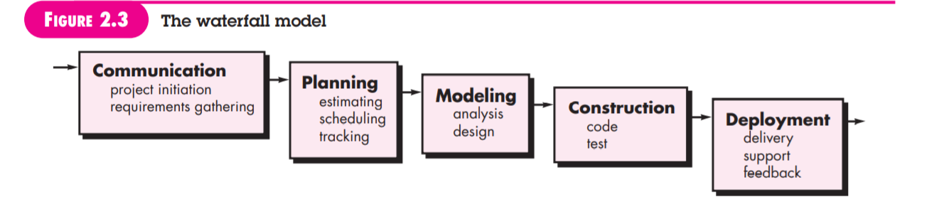
Software Process model
Waterfall model
Requirement are well understood

Slide 23
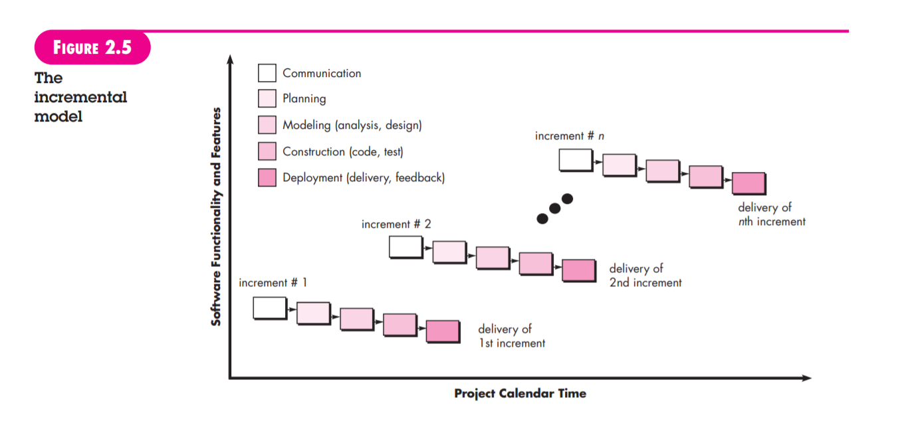
Software process model
Incremental model
When an incremental model is used, the first increment is often a core product
IF there may be a compelling need to provide a limited set of software functionality to users quickly and then refine and expand on that functionality in later software releases.

Slide 24
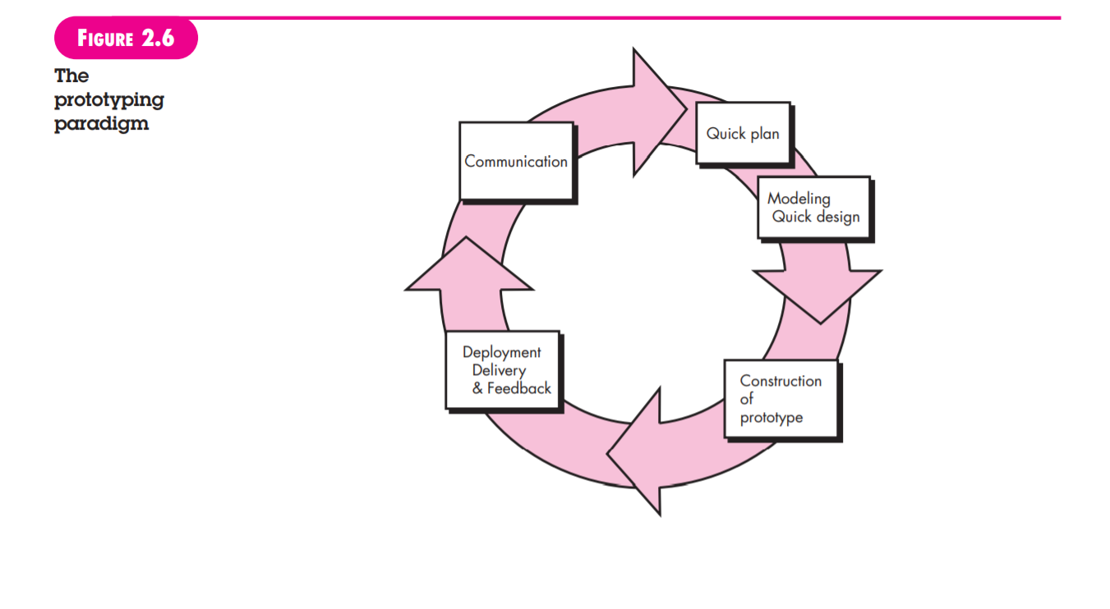
Software Process model
Prototype model
Often, a customer defines a set of general objectives for software, but does not identify detailed requirements for functions and features. In other cases, the developer may be unsure of the efficiency of an algorithm

Slide 25
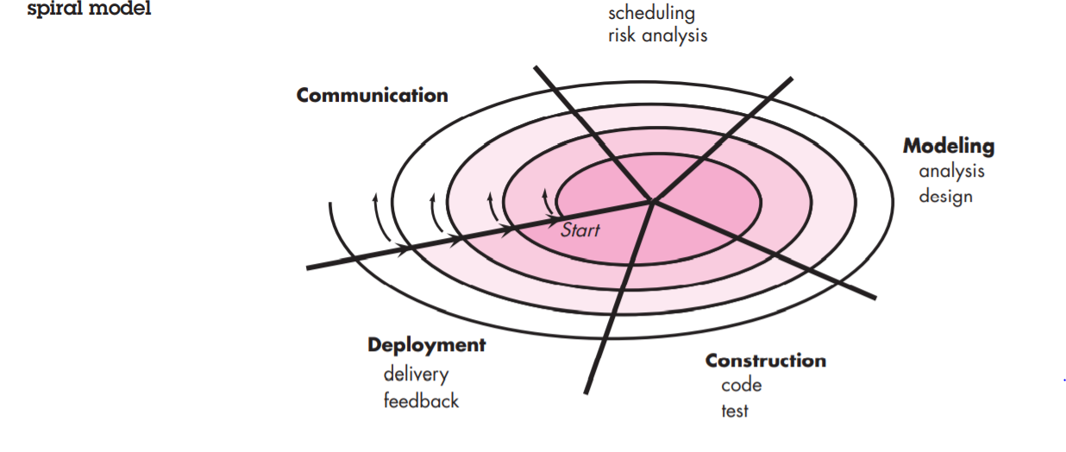
Software Process Model
Spiral Model
The spiral development model is a risk-driven process model generator that is used to guide multi-stakeholder concurrent engineering of software intensive systems

Slide 26
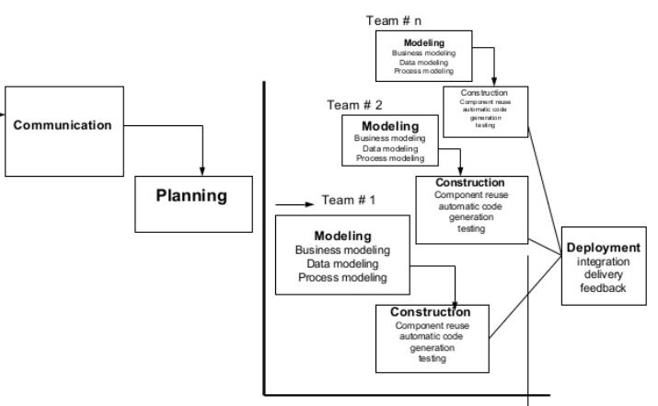
Software process model
Rapid Application Development
60 to 90 days

Slide 27
Software process model
Agile
Agility has become today’s buzzword when describing a modern software process.
An agile team quickly respond to changes.
Change is what software development is very much about.
Agility has 12 principles and four guidelines

Slide 28
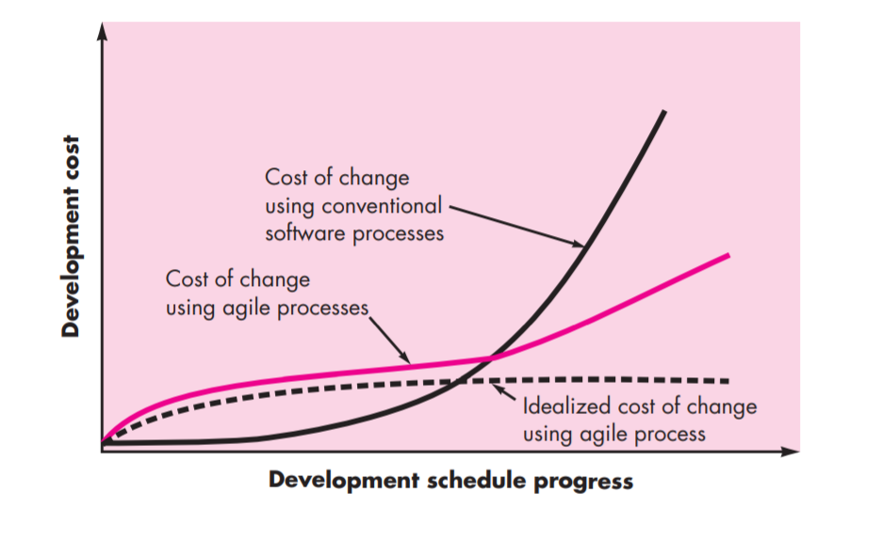
Software process model
Agile Process

Slide 29
Software process model
Scrum
It is one of the popular framework for the agile software development
If you go to scrum.org it defines its Better way Of Building Product.
Other popular frameworks are Kanban, Extreme Programming (XP)

Slide 30
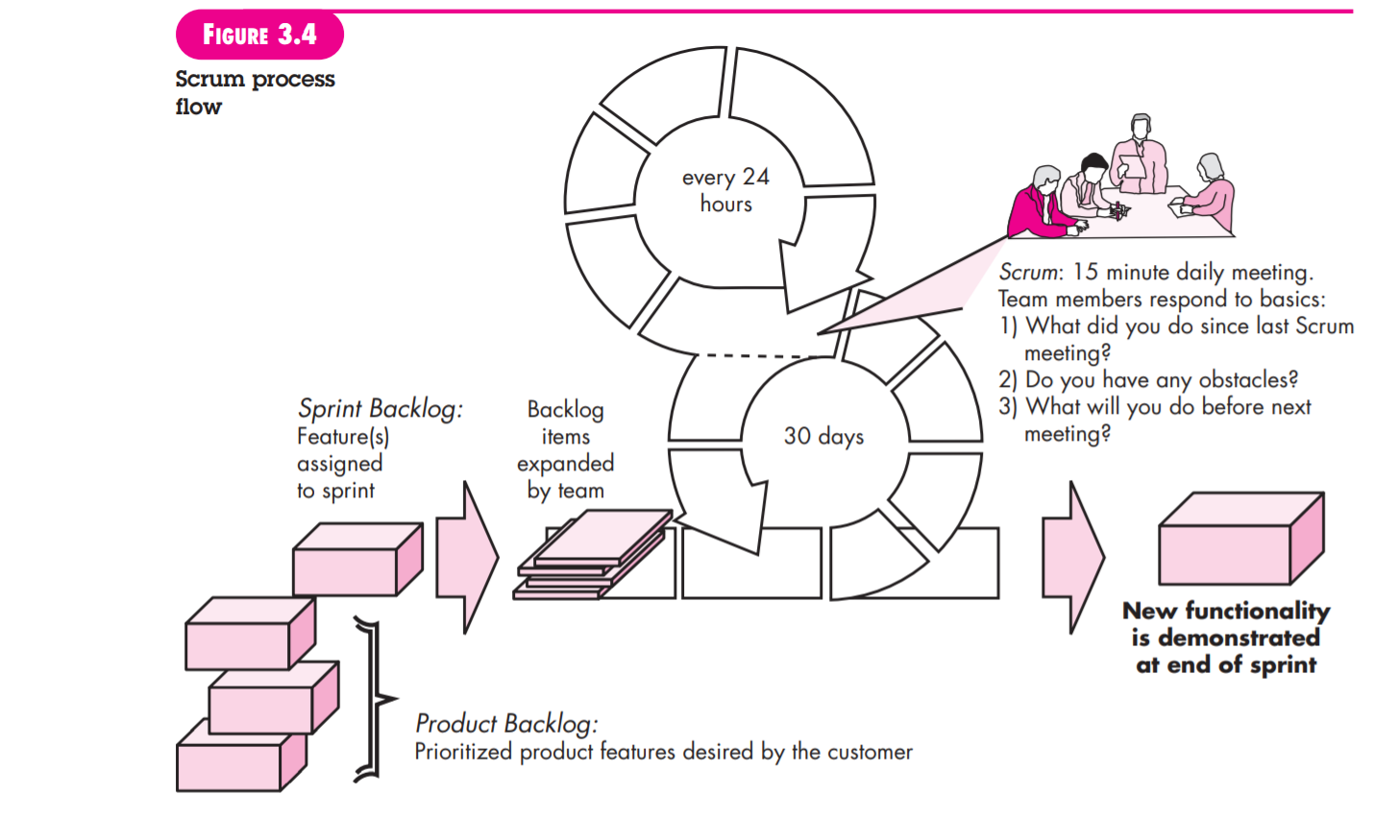
Software process model
Backlog

Slide 31
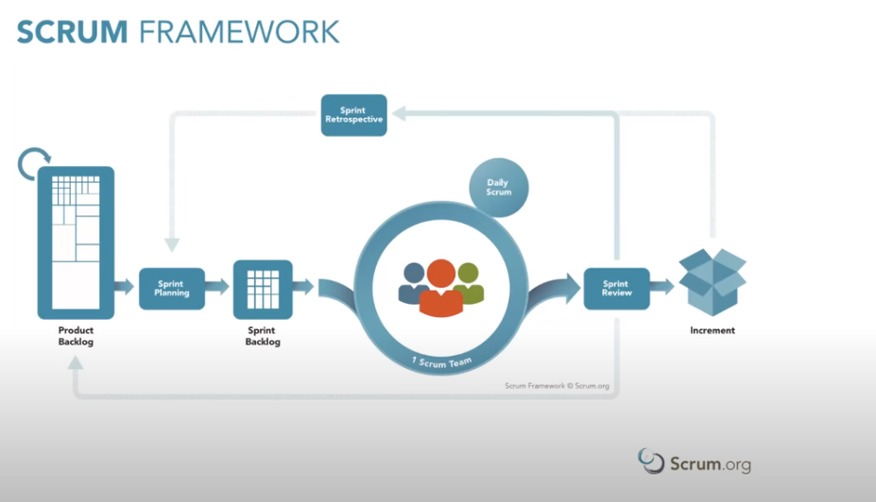
Software process model
Scrum process

Slide 32
Scrum
Backlog :
Items can be added to the backlog at any time (this is how changes are introduced).
The product owner assesses the backlog and updates priorities as required.
Sprint:
consist of work units that are required to achieve a requirement defined in the backlog that must be fit into a predefined time-box(typically 30 days).

Slide 33
Scrum
Scrum Meeting
Scrum meetings are short (typically 15 minutes) meetings held daily by the Scrum team.
Three key questions are asked and answered by all team members
• What did you do since the last team meeting?
• What obstacles are you encountering?
• What do you plan to accomplish by the next team meeting?

Slide 34
SCRUM
A team leader, Scrum master, leads the meeting and assesses the responses from each person.
The Scrum meeting helps the team to uncover potential problems as early as possible.
Demos:
Deliver the software increment to the customer so that functionality that has been implemented can be demonstrated and evaluated by the customer.
Demo may not contain all planned functionality, but rather those functions that can be delivered within the time-box that was established

Slide 35
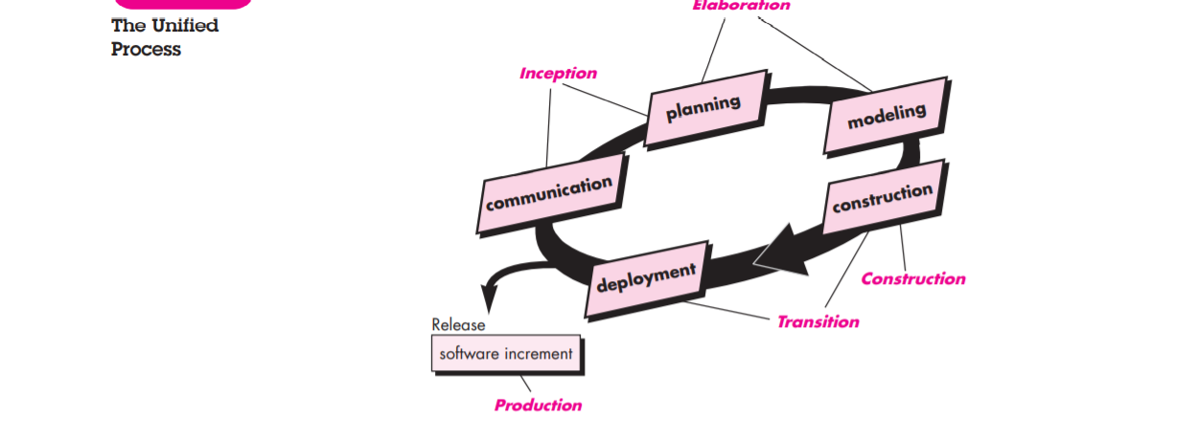
Process model
Unified process
Fig : The Unified process

Slide 36
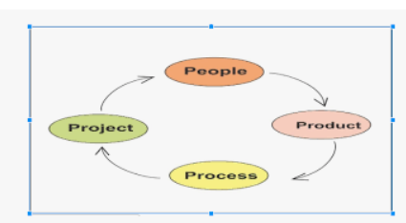
Four Ps in software Engineering

Slide 37
People
People are the key factor in the software development
The following categories of people are involved in the software process.
Senior Managers
Project Managers
Practitioners--Developers
Customers
End Users

Slide 38
Product
Before a project can be planned, product objectives and scope should be established.
Without product information it is impossible to define reasonable estimates of the cost.

Slide 39
Process
A method provides the framework from that a comprehensive arrange for development is established

Slide 40
Project
We conduct planned and controlled software projects to manage complexity of project.
To avoid project failure a software project manager and software engineers who built the project must :
Develop a common sense approach for planning, monitoring, and controlling the project

